Slide 1

Online Shopee System
Minor Project - I
CS- 508
Problem Statement: To improve the online shoe shopping experience by addressing issues related to sizing accuracy, product information, foot health education, customization options, returns, sustainability, user reviews, mobile optimization, and security.
Project Group Number : 25
Group Member Details: Asmi Anand (0187CS211042)
Ch. Ardesh Singh(0187CS211054)
Amit kumar (0187CS211023)
Guide Details: Prof.Bhavna Soni Mam

Slide 2
Idea/Approach Details
Abstract:
The "All About Feet" website is a comprehensive online platform dedicated to footwear and foot care. This website serves as a valuable resource for footwear enthusiasts, consumers, and individuals seeking information and guidance on proper foot care.
Describe your idea Solution/Prototype here:
AI Sizing Assistant: Implement AI-based sizing recommendations.
Detailed Product Info: Provide comprehensive product descriptions and images.
Foot Health Section: Offer foot health education and advice.
Customization Feature: Allow users to personalize shoe options.
Efficient Returns Process: Streamline returns with virtual try-ons and clear policies.
Sustainability Filters: Enable filtering by eco-friendly options.
Describe your Technology stack here:
Front-End: HTML, CSS, JavaScript, Bootstrap.
Back-End: Python or Php.
Database: MySQL
Version Control: Git or GitHub.
Security: SSL, security plugins
Analytics: Google Analytics
Mobile Optimization: Responsive design

Slide 3
Project Requirements
Functional Requirements
Non Functional Requirements
User Registration/Login: User accounts and login system.
Product Listings: Display shoes with details.
Shopping Cart and Checkout: Add items, review, and pay.
Search and Filters: Find products easily.
User Reviews and Ratings: Leave feedback.
Order Tracking: Monitor order status.
Customer Support: Contact for assistance.
Admin Panel: Manage products and orders.
Responsive Design: Works on all devices.
Security: Protect user data and payments.
Analytics: Track website performance.
Social Sharing: Share products online.
Return/Refund Process: Handle returns.
Performance: Fast page loads, scalable for traffic spikes.
Usability: Intuitive design, accessibility compliant.
Security: HTTPS, data encryption, regular audits.
Reliability: High uptime, reliable transactions.
Scalability: Handles growth, load balancing.
Availability: 24/7 support, minimal downtime.
Compatibility: Cross-browser, mobile-friendly.
Data Backup: Regular backups, quick recovery.
Regulatory Compliance: Data protection laws, e-commerce standards.
Performance Monitoring: Real-time tracking and alerts.
Load Testing: Handles expected and extreme loads.
Integration: Seamless third-party integration.
Data Privacy: Clear privacy policies and consent.

Slide 4
Project Requirements
Hardware and Software requirements (Developer)
Hardware and Software requirements (Client)
Computer: Modern computer with multi-core processor.
RAM: At least 8GB of RAM.
Storage: Ample storage space, preferably an SSD.
Monitor: High-resolution monitor or dual monitors.
Internet: Stable and fast internet connection.
Mobile Devices: Various mobile devices for testing.
Operating System: Windows, macOS, or Linux.
Text Editor/IDE: Visual Studio Code, Sublime Text, or an IDE like WebStorm.
Web Browsers: Chrome, Firefox, Edge, and Safari for testing.
Version Control: Git and a platform like GitHub or GitLab.
Front-End: HTML/CSS, JavaScript, and a framework if needed.
Back-End: Python or PHP.

Slide 5
Design
Describe data flow diagram here(if applicable)
Describe your ER Diagram here(if applicable)

Slide 6
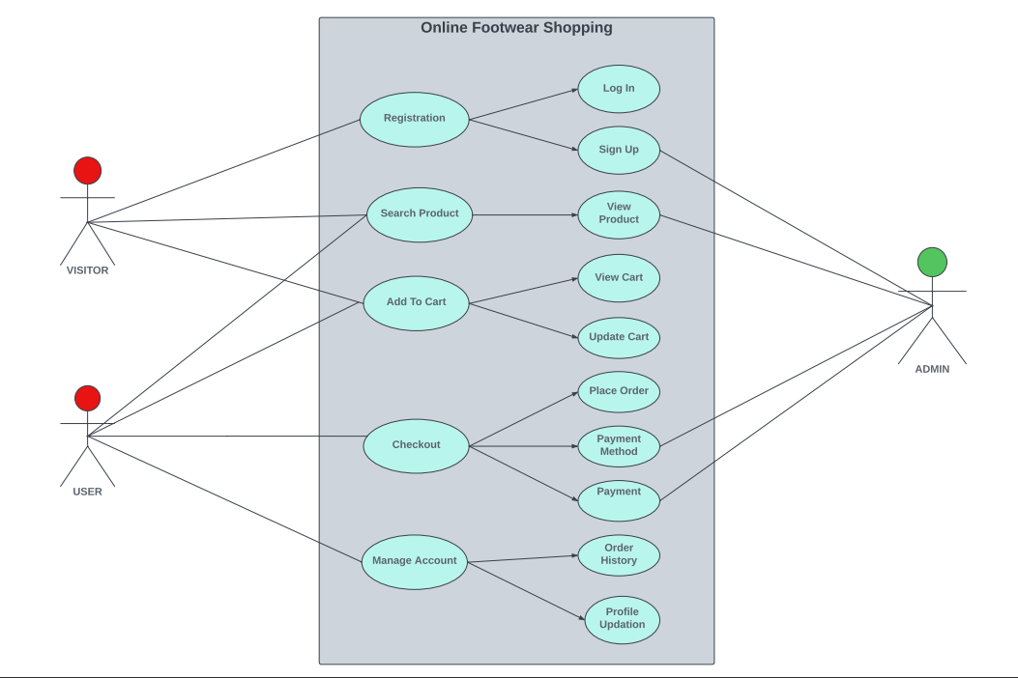
Design
Describe your Use Cases here
Describe your Dependencies / Show stopper here

Slide 7
Deployment Details
Describe Deployment Details here
Database: Deploy and configure the chosen database system (e.g., MySQL or PostgreSQL).
Version Control: Use Git for version control and host the code on platforms like GitHub or GitLab.
Deployment Environment: Maintain separate environments for development, testing, and production.
Database Backup: Set up automated database backups for data safety.
Backup and Recovery: Plan for disaster recovery and regular backups.
Testing in Production: Test the deployment in the production environment before finalizing.
Rollback Plan: Prepare a rollback plan in case of deployment issues.

Slide 8
Monetary Support
Financial Requirements
Development: Website creation, content, and e-commerce platform costs.
Marketing: Budget for advertising, SEO, social media, and email campaigns.
Analytics: Subscription fees for data tools and services.
Shipping: Shipping, packaging, and logistics expenses.
Returns: Costs associated with handling returns and potential revenue loss.
Sustainability: Expenses for sustainable and ethical practices.
Profit Margins: Set clear revenue and profit goals for sustainability and growth.

Slide 9
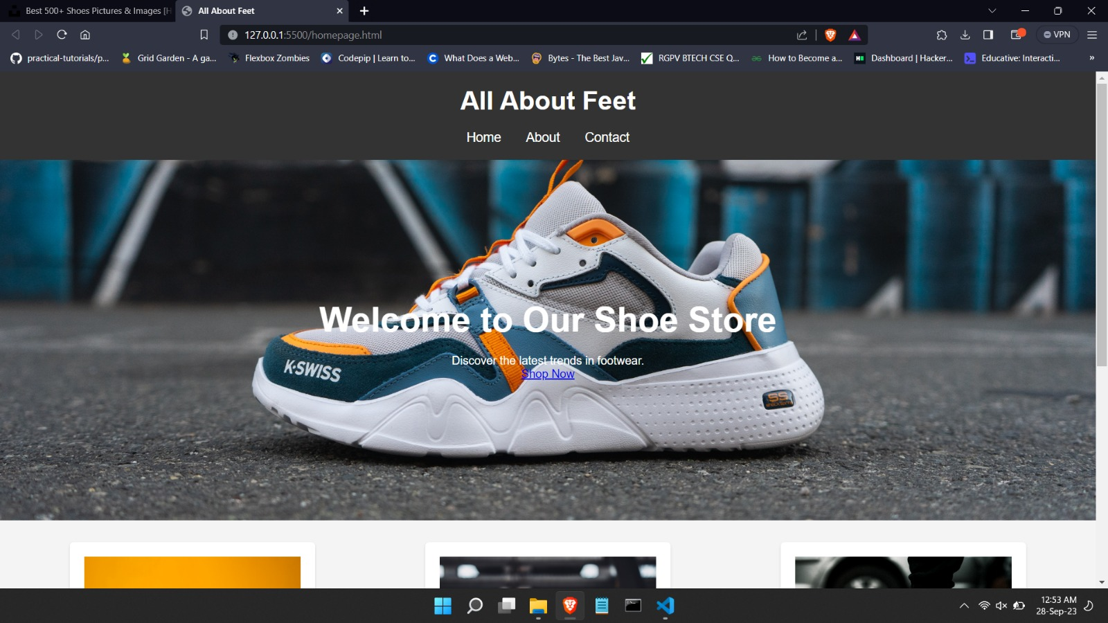

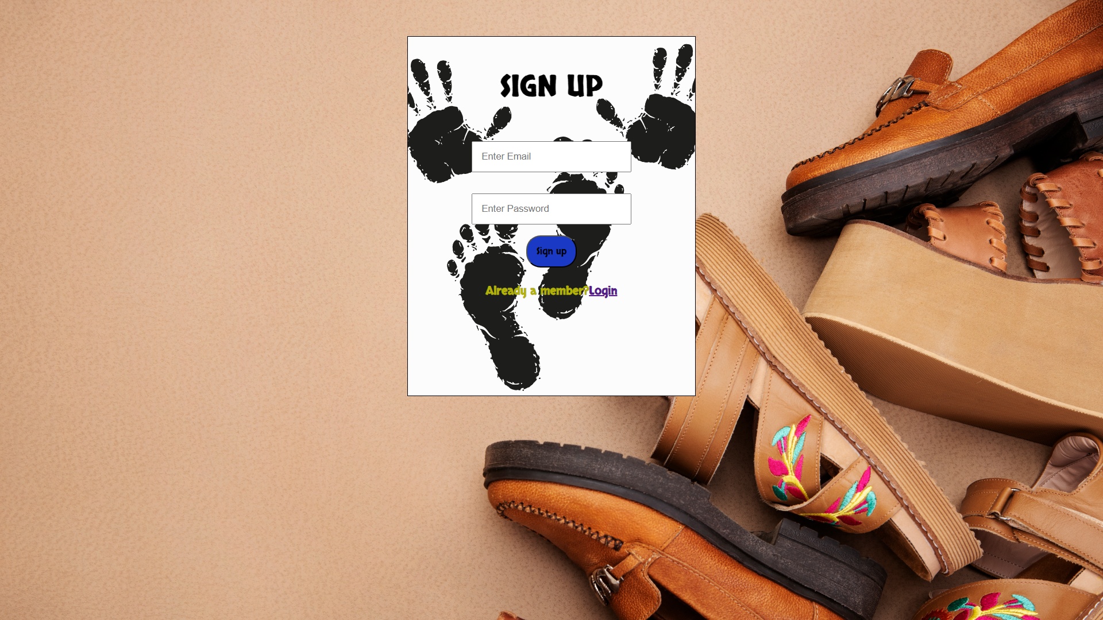
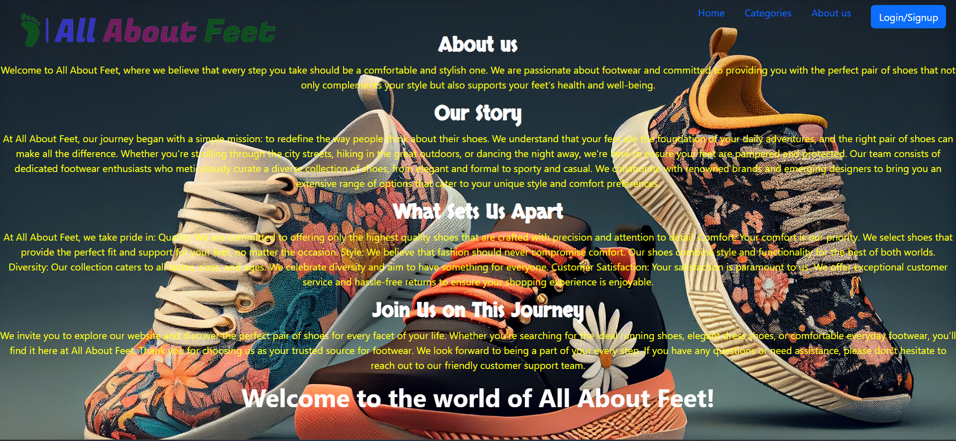
Project Screenshot
Home | Login
Signup | About us

Slide 10


